Slide 1
Tone Review #4
Comparing Texts
Magazine Cover
Tweet

Slide 2
Highlight reasons why Trump thinks kneeling is wrong.
What is his tone toward kneeling?

Slide 3
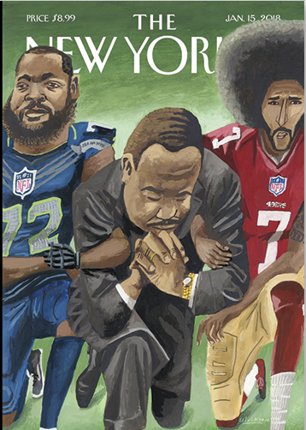
The New Yorker
January 18, 2018
Who are the people in the picture?
What is the tone toward kneeling?

Slide 4
Open a fresh email and type:
One SAT-style question about the relationship between tone in the tweet and the magazine cover.
4 answer choices
Indicate the correct answer
A detailed explanation (two sentences) of why your answer is correct. Remember that sometimes you can help explain why your answer is right by noting why the other choices are wrong.
Submit to:
cremar@cbsd.org
In the subject line, type: #Block2

